Slide 1
Model-based Systems Engineering of The OSIRIS-REx Mission's Science Processing and Operations Center
Space Grant Symposium
April 12th 2014
Joel Mueting
University of Arizona
OSIRIS-REx Science Processing and Operations Center
Systems Engineering Team

Slide 2
What is OSIRIS-REx?
The third planetary science mission selected for development in NASA’s New Frontiers Program
Launch in September 2016 – encounter Bennu in October 2018.
Study Bennu for up to 505 days, mapping the surface from an orbit of a few kilometers.
Obtain at least 60 g of pristine regolith.
Return to earth in September 2023. Capsule landing in Utah Test Range.
Deliver samples to Johnson Space Center curation facility for world-wide distribution.
Notes:
Launch in September 2016, encountering asteroid (101955) Bennu in October 2018
Study Bennu for up to 505 days, globally mapping the surface from a distance of 5 km to a distance of 0.7 km
Obtain at least 60 g of pristine regolith and a surface material sample
Return to Earth in September 2023 in a Stardust-heritage Sample Return Capsule (SRC)
Deliver samples to the NASA Johnson Space Center (JSC) curation facility for world-wide distribution

Slide 3
OSIRIS-REx and the SPOC
Origins
Spectral Interpretation
Resource
Identification
Security
Regolith
Explorer
Science
Processing
Operations
Center

Slide 4
Problem Statement
Identify and implement the most effective method to manage the Science Processing and Operations Center system architecture and its interactions with other elements of the Ground System.
Tasks:
Capture all system requirements
Generate documentation
Encapsulate all levels of the system architecture
Be able to integrate seamlessly with other ground elements.
Notes:
Some problems to consider:
Requirements have different levels, parents & children. How can this be captured?

Slide 5
OSIRIS-REx Ground System
Ground System
FDS-MSA Interface
Flight Dynamics
(FDS)
Mission Support Area
(MSA)
SPOC-FDS Interface
SPOC-MSA Interface
Science Processing Operations Center
(SPOC)

Slide 6
Methods
Use model-based systems engineering software and methodologies to create a multi-layered architecture of the SPOC.
Create a database that encapsulates this model and be configuration managed later in the mission.
Use model to generate documentation for the SPOC system to ensure that vital information is accessible to all team members.
Notes:
The term ‘multi-layered’ is very important. Use requirements slide to show why.
Use model to create documentation and make it available to all team members. This is important so that everyone can see what the SPOC systems engineering team is doing. Our job is to accurately model each element of the spoc and what every team member is doing. This way team members can see how we have modeled their elements and interact with us to iteratively change the model and update it. This has been a valuable finding. As we create elements of the architecture, we show that part of the model to those in the SPOC that it affects and we can verify that we are all on the same page and the model is correct. More often than not, the model incites discussion, re-design of elements, and rarely requirements changes.
Talk about MBSE definition.

Slide 7
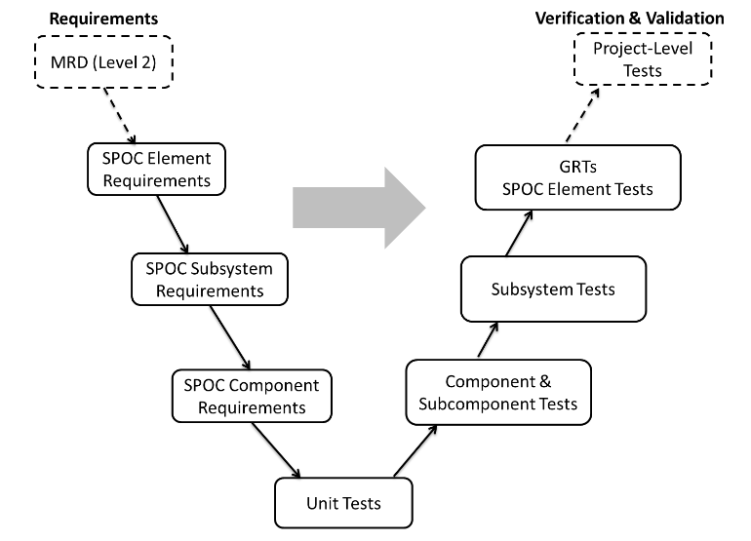
Methods

Slide 8
SPOC Requirements Flowdown
SPOC Allocated MRDs
SPOC Element Requirements
ICDs
Element Level Requirement Allocations
Instrument Data Processing
Data Repository
Instrument Planning and Operations
Science Data Processing
Science Data Analysis
DV
ATLO
SPOC Operations
SPOC Infrastructures
Notes:
Talk about MRD and requirements flow down. The mission is not a single level entity it is a hierarchical structure. Therefore the SPOC architecture and requirements should also be this way. CORE allows us to create a hierarchical model.

Slide 9
SPOC Element Requirements Example
Level II (MRD) Parent Requirements
 | SPOC Level III Requirement | Statement | Rationale
MRD-144: OSIRIS-REx shall detect with >95% confidence natural satellites >10cm diameter with albedo >0.02 within 31km of Bennu.
 | SPOC-SDP-3.11 | The SPOC shall produce images and proof of existence of detected natural satellites by the end of the Approach phase. | Presence and orbit of satellites are needed for safety assessment. Detection of any satellite requires detailed mapping of the asteroid gravity field prior to orbital insertion; presence of satellite important to constrain dynamical history.
MRD-116: OSIRIS-REx shall, for > 80% of a 2-sigma TAG delivery error ellipse around at least 2 candidate sampling sites map the areal distribution and determine the particle size-frequency distribution of regolith grains < 2-cm in longest dimension.
 | SPOC-SDP-3.17 | The SPOC shall produce particle size frequency distribution graphs around at least 2 candidate sampling sites. | Required to assess if the particle size-frequency distribution is compatible with TAGSAM capabilities and to assess sampleability of candidate sample sites.
MRD-133: OSIRIS-REx shall determine the mass of Bennu to within 0.5%.
 | SPOC-SDP-3..36 | The SPOC shall produce an estimate of the mass of Bennu. | Mass needed to determine the density.
MRD-118: OSIRIS-REx shall, for > 40% of a 2-sigma TAG delivery error ellipse around at least the prime sampling site, map the distribution of key species listed in the MRD-118 Table (Absorption Features of Key Mineralogical & Organic Molecules) that have spectral features with > 5% absorption depth at a spatial resolution < 5m.
 | SPOC-SDP-3.45 | The SPOC shall produce Sample Site Mineral and Chemical Abundance Maps around at least the prime sampling site to map the distribution of key species (H2O, Phyllosilicate, Carbonate, Sulfate, Silicate, Oxide, PAH, and Aliphatics). | Provides information to identify spectrally interesting regions on the scale of the sample ellipse; key minerals and organics determined by comparison to carbonaceous chondrites.
Notes:
This is used as an example of the requirements used to build the architecture.

Slide 10
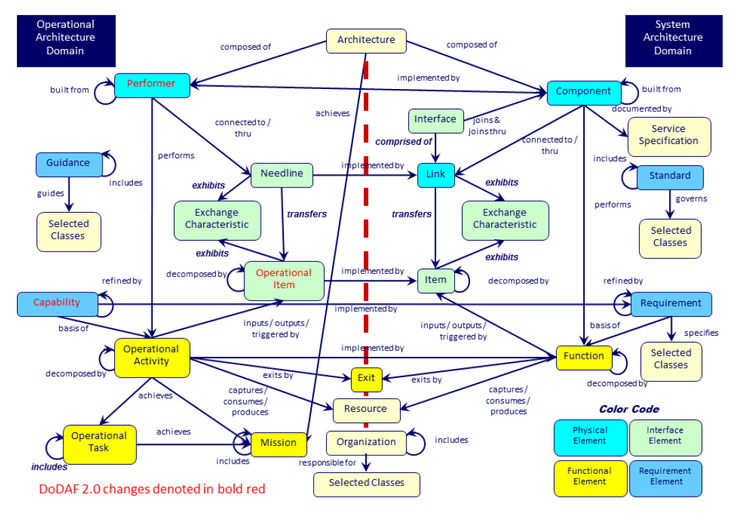
CORE Functionality

Slide 11
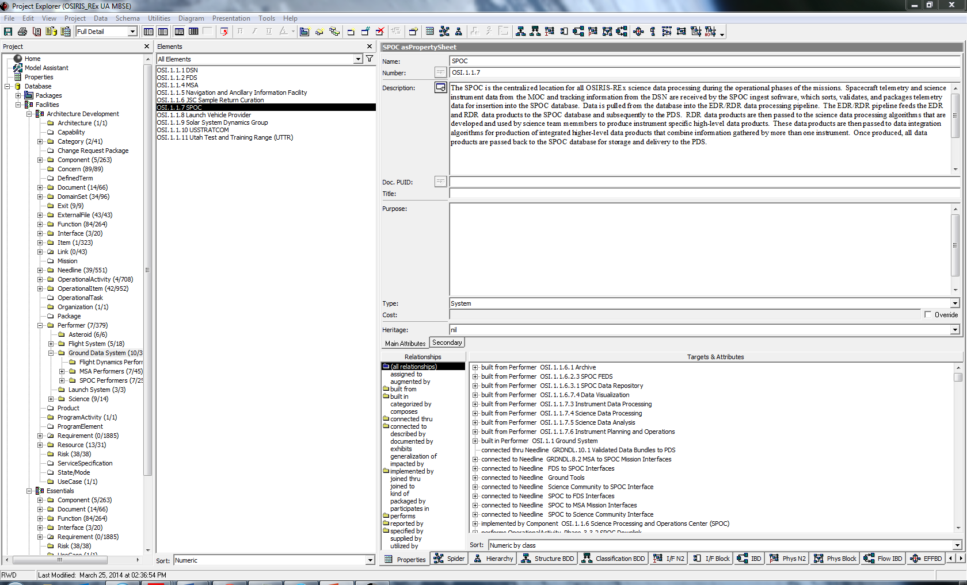
CORE Example
Elements
Properties
Connections

Slide 12
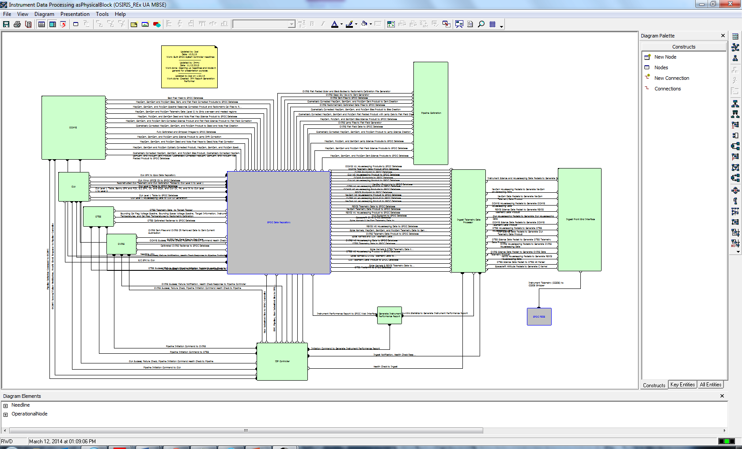
CORE Example

Slide 13
Results
SPOC Architecture and external interfaces are now successfully captured in CORE 8 with minor changes still ongoing.
Use of MBSE software for systems engineering has been well-received.
Using visual model to verify with team members that the architecture was captured correctly often led to discussion on interpretation of requirements and redesign of model.
Hashed out problems that otherwise may have been overlooked with a traditional architecture.
Notes:
Ensured that everyone was on the same page.

Slide 14
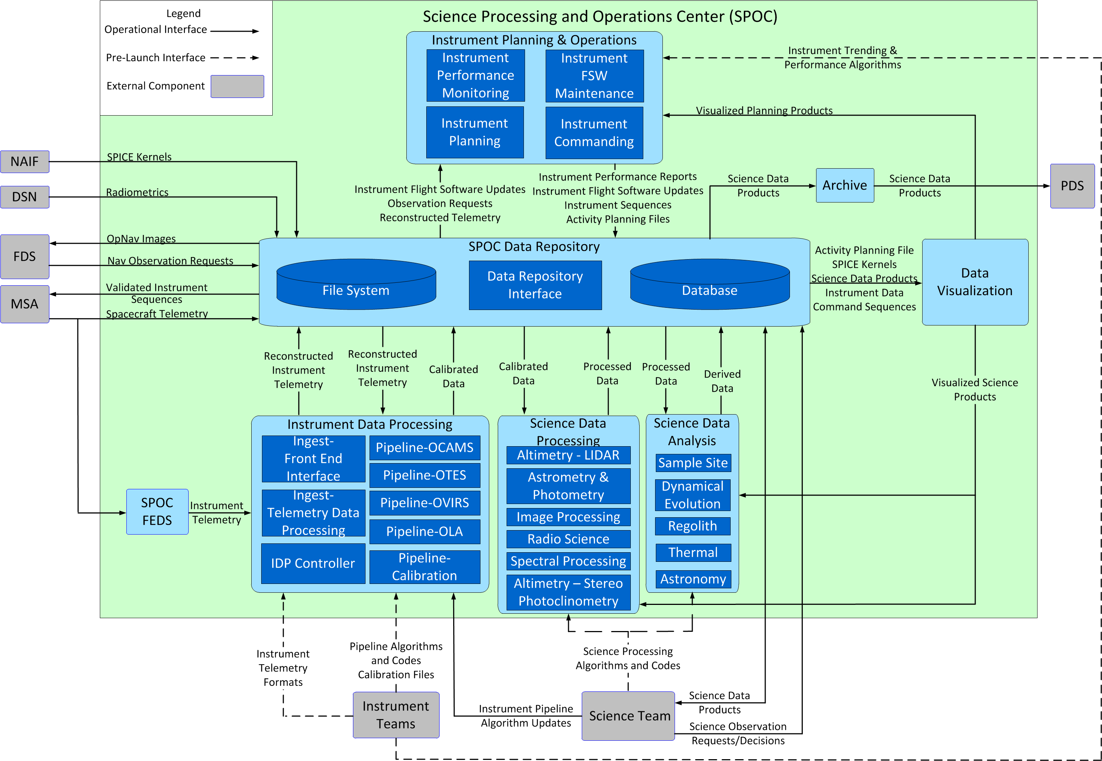
SPOC Functional Architecture

Slide 15
Results (cont.)
SPOC Interfaces are captured in the SPOC CORE Database
Identified interfaces between SPOC and other GS Elements and that data that is passed between them
Data transferred between GS/external elements and the SPOC are captured as individual items
Lists data that is passed across the interfaces, along with basic format
Item descriptions, properties, and relationships are employed to support document generation (ICDs and OIAs)
Notes:
All interface documents will soon be generated by core.

Slide 16
Conclusions
Using CORE visuals has encouraged team involvement in systems engineering process allowing problems to be found and addressed early on.
Usefulness of model-based systems engineering approach for space missions has been demonstrated and well-received by industry professionals.
Future use of model-based systems engineering on space missions is anticipated.
Notes:
Talk about establishing heritage.

Slide 17
Backup

Slide 18
SPOC SE Tasks Since PDR
Update Requirements
Revise and flowdown based on MRD updates
Update and revise lower level requirements based on furthered development and understanding
Finalized SPOC Functional Architecture
Captured in CORE
Review and update Interfaces
More detail in ICDs
Write OIAs
GS Interface meetings
Update Documentation
SPOC CDRLs
MAIP
V&V and I&T Plan
Element and Subsystem Requirement Documents
ICDs and OIAs
SPOC-FDS ICD, OIA Documents
SPOC-MSA ICD, OIA Documents
SPOC Instrument ICDs
SPOC Science ICD

Slide 19
SPOC Interfaces
Interface Documentation:
ICD: Interface Control Document
OIA: Operational Interface Agreement
SIS: Software Interface Specification
External Interfaces
MSA
FDS
Science Team
Instrument Team (Phase C/D Only)
PDS Archive

